Slide 1

Wine Für dich, Für uns, Für alle
Bluberry Winery
Code Analytics
Arun & Jay
26.02.2021

Slide 2
AGENDA
02.
04.
03.
05.
Introduction
01.
What, Why our story needs to be heard
Data Collection
Data Analysis
Exploratory analysis
Machine Learning Methods
Model Validation
What we found/have
Methods/Analysis Plan
Price Prediction
What we going to do
Price prediction
Price Suggestion

Slide 3

01.
Introduction
Background - Why our story needs to be heard
Goal - What we want to tell

Slide 4
Background
Blueberry Winery is one of the start-up Wine Manufacturing company in Portugal.
Blueberry Winery is trying to enter the business with a good amount of analytics & research on domain knowledge
Goal
Blueberry Winery wants to achieve the best 'Customer Satisfaction’ towards the Quality and Price
To Analyse and find the composition of factors that contribute to the quality wine

Slide 5
02.
Data Collection
What we get

Slide 6


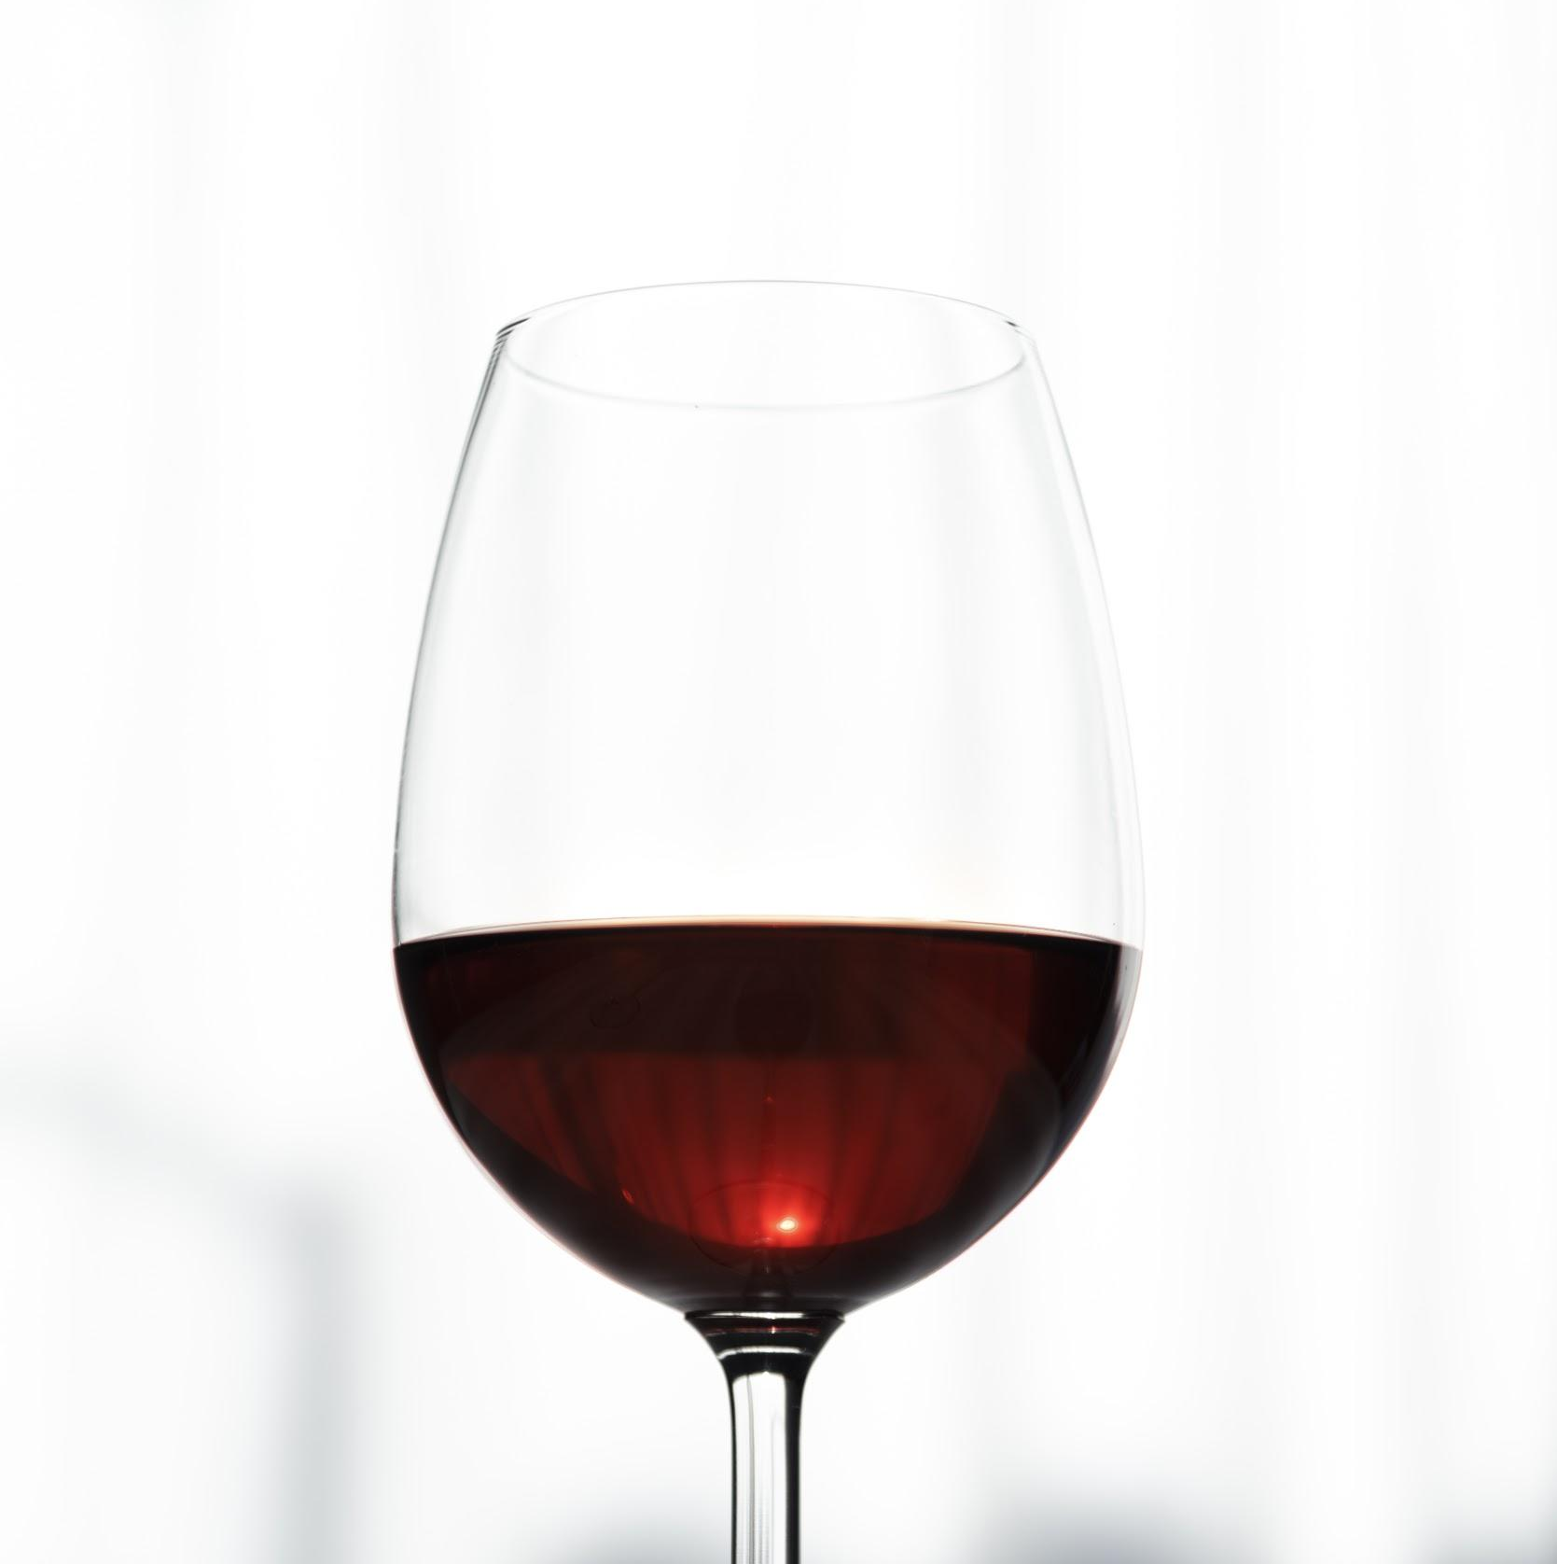
Wine Types
White Wine
Fixed Acidity
Volatile Acidity
Citric Acid
Residual Sugar
Chlorides
Free sulfur dioxide
Total sulfur dioxide
Density
pH
Sulphates
Alcohol
Quality
DataAttributes / Ingredients
Red Wine

Slide 7
03.
Methods/Analysis Plan
How we want to find the valuable insights from the data

Slide 8
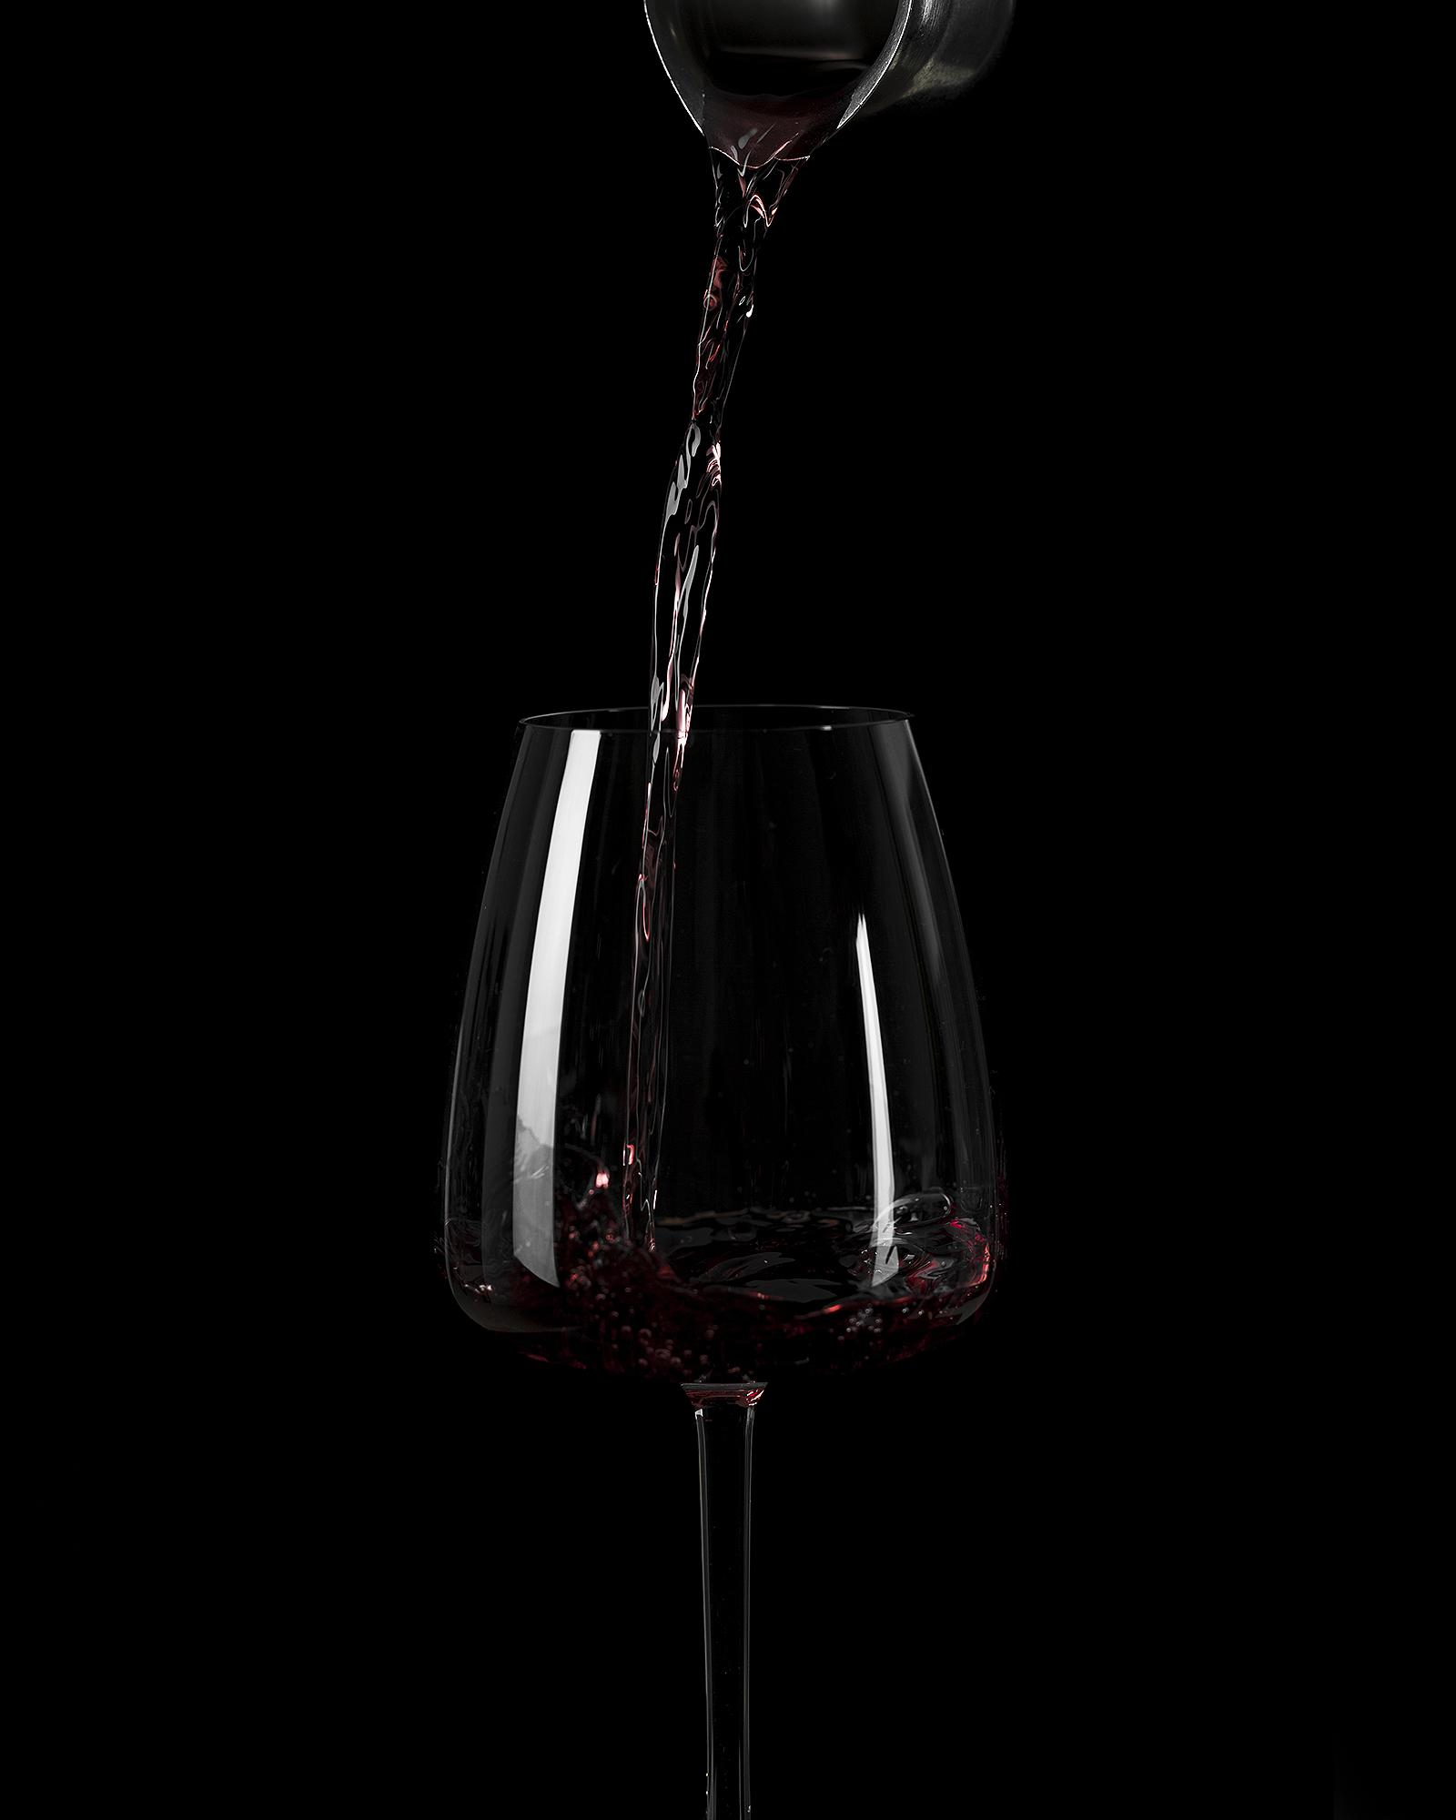

Analysis - Questions
Which factor or combination of factors affect the quality of red & white wines?
Question 1
Do the different types of wines have different factors affecting quality?
Question 2
Is there any other interesting trends that exist in other columns besides quality?
Question 3

Slide 9
Analysis - Methods
Using Exploratory Data Analysis to find the distribution of factors of each Variable
Method 1
Using Machine Learning Methods to find the Best Composition factors to contribute the quality wine
Method 2
Explore Sales dataset and predict the price for the wine quality
Method 3

Slide 10
04.
Data Analysis
Results - Exploratory analysis
Feature Selection
Machine Learning Methods

Slide 11
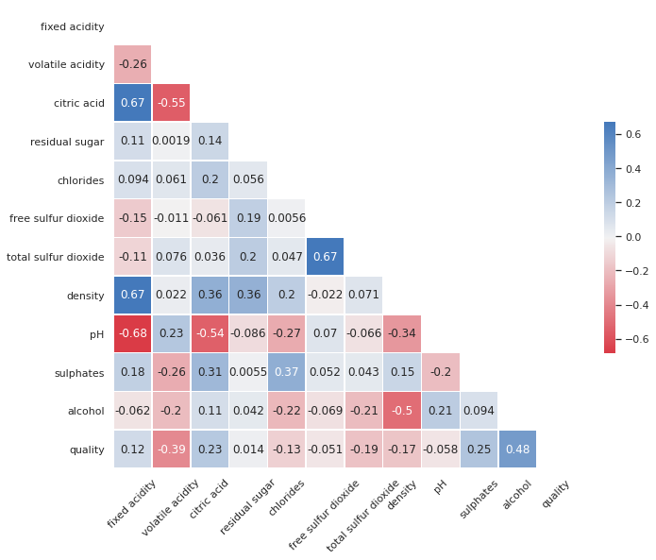
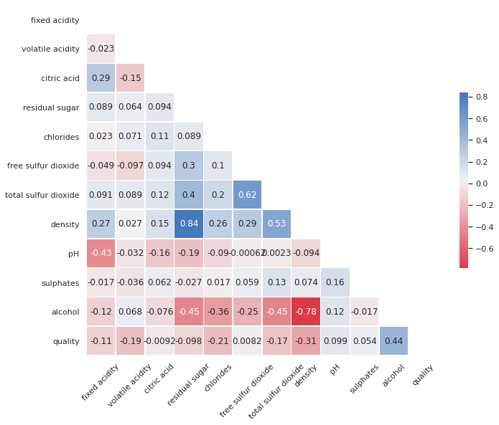
Correlation between all variables for red & white
red wine
white wine

Slide 12
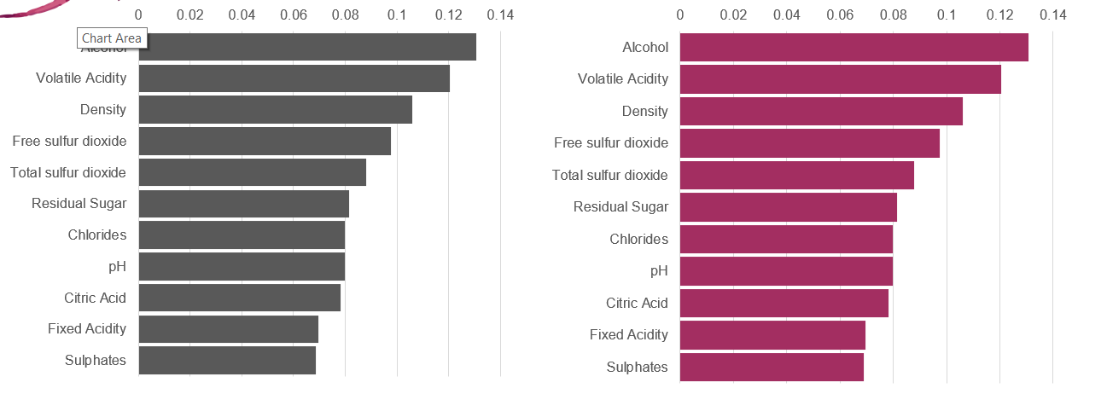
Important Factors towards predicting Wine Quality
White Wine
Red Wine

Slide 13
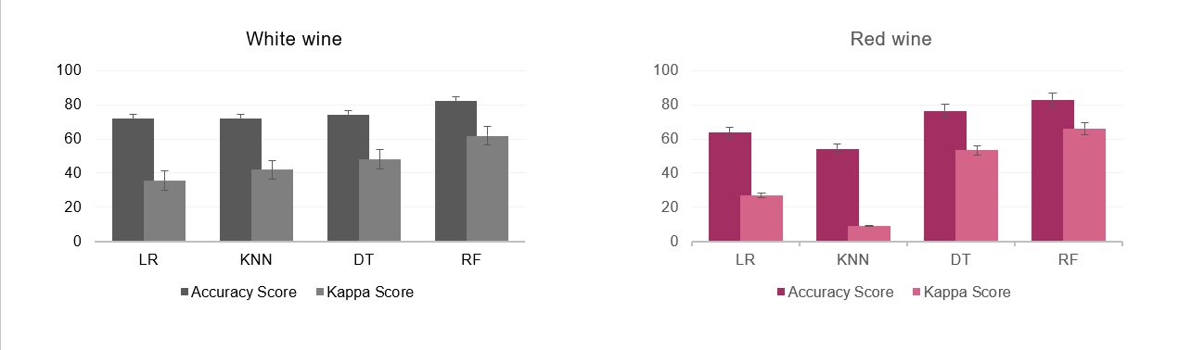
Machine Learning Model Scores
LR – Logistic Regression Algorithm
KNN – K Nearest Neighbor’s Algorithm
DT – Decision Tree Classifier Algorithm
RF – Random Forrest Classifier Algorithm

Slide 14
05.
Price Prediction
Sales Dataset Exploration
Price Prediction & Suggestion

Slide 15
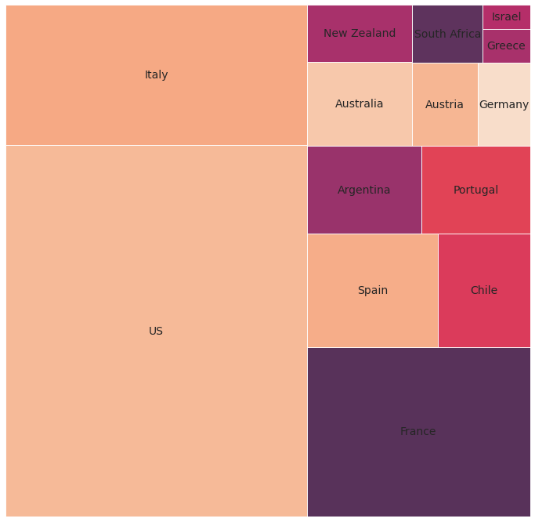
Sales data distribution

Slide 16
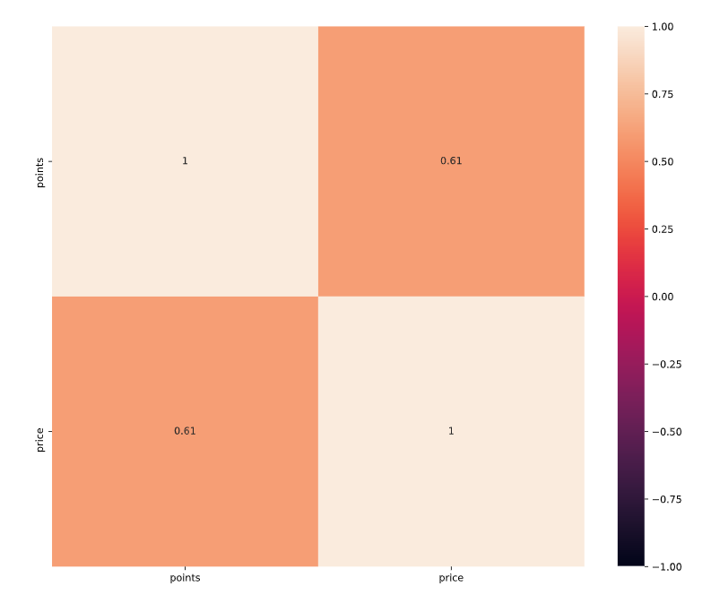
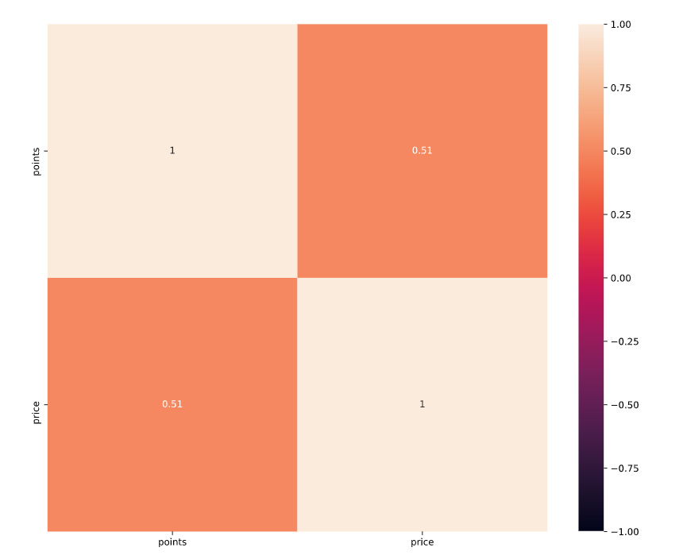
Points Vs Prize - Correlation
White Wine
Red Wine

Slide 17
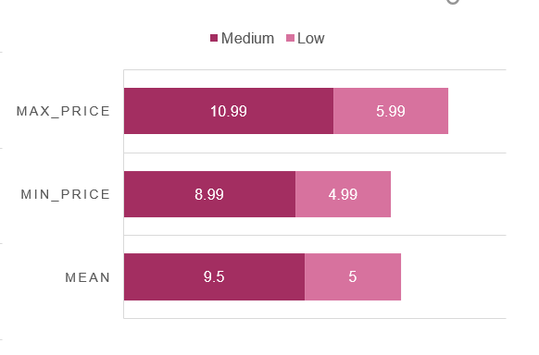
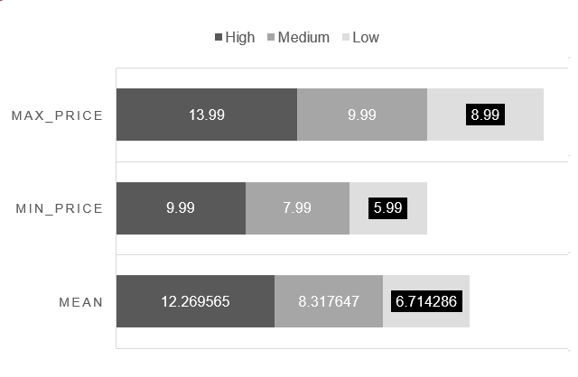
Comparison of estimated price for wines in dataset1 to the price in the dataset2
White Wine
Red Wine

Slide 18



THANKS
Do you have any questions?

Slide 19
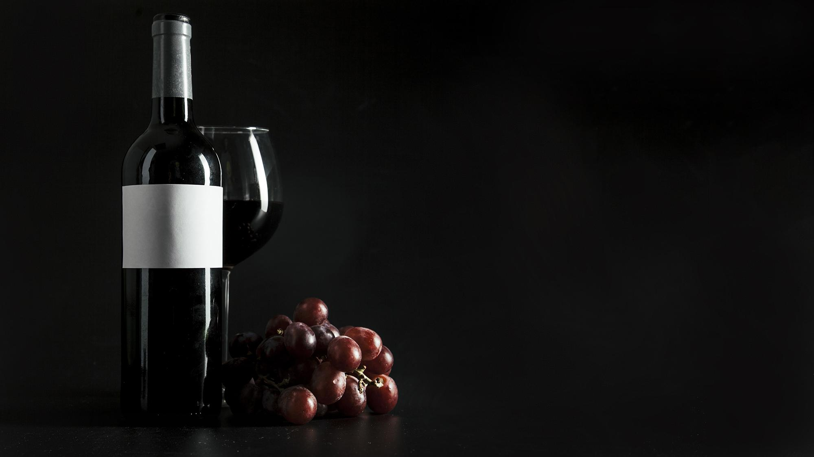
Wine
Für dich, Für uns, Für alle

